Slide 1
CS 422 - Group 4
Medication Manager
Luqmaan Baiyat, KT Mancillas, Keval Patel, Jose E. Rodriguez,
Mohammed Shafiuddin

Slide 2
Problem Space - Opioid Addiction
According to the National Institute on Drug Abuse:
“Roughly 21 to 29 percent of patients prescribed opioids for chronic pain misuse them.”
“Between 8 and 12 percent develop an opioid use disorder.”
“An estimated 4 to 6 percent who misuse prescription opioids transition to heroin.”
“About 80 percent of people who use heroin first misused prescription opioids.”
Our goal is to help patients keep better track their medication usage and also remind them when it’s the right time to take them.

Slide 3
Interviews
We learned…
Medication label may be confusing/difficult to read.
People may have difficulty remembering when to take medications.
Some people look for alternatives for their medications.
Others may be uninformed or ignorant about the side effects of medication.

Slide 4
Goals
Notify the user when they need to take their medication.
Allow the user to view a history of when they’ve taken their medication in the past.
Allow the user to manage their current medications by adding, deleting, and editing them to the manager.

Slide 5
Scenario
Joslyn, a 72 year old retired woman with joint pain would like to:
Add 3 medications which she is currently taking to the medication manager
Receive notifications on her device when it’s time to take each medication
View her medications taken for the last 7 days once at the end of every week.

Slide 6
Prototype 1
Overview: For this iteration, the prototype was based on elements from each group member’s designs. After completing testing for the first prototype, the main takeaway was that critical elements were missing from the prototype, such as feedback for completing actions as well as disambiguous labels for some actions.

Slide 7
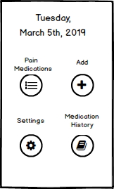
Prototype 1 User Testing
Adding a New Medication: After adding a new medication, there was no visible feedback to the user notifying them that the medication was successfully added.
The user is sent to the home screen of the application after successfully adding a new medication, but no notification was given.

Slide 8
Prototype 1 User Testing
Accessing Current Medications: During testing, there was confusion on how to access the page listing the user’s current medications. This was caused by the ambiguous button labels Pain Medications and Medication History. To access the current medications, the button labeled Pain Medications had to be pressed, but the Medication History button was pressed first in some instances.
Clicking the button outlined in green was the correct action, but some users click the red outlined button.

Slide 9
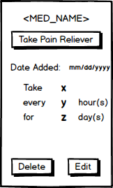
Prototype 1 User Testing
Editing an Existing Medication: When users were asked to edit an already existing medication, they were trying to directly edit the fields that displayed the information before reluctantly clicking the edit button. Clicking the edit button was required to redirect the user to the edit medication screen which would allow them to complete the task.

Slide 10
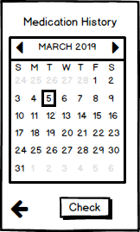
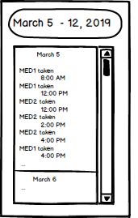
Prototype 1 User Testing
Checking Medication History: The medication history interface was confusing for users, since selecting a date on the calendar would list all the medications taken from the selected date to the current date, instead of just listing the medications taken for the selected date.

Slide 11
Prototype 2
For the second iteration of prototyping, the following changes were made from the first iteration:
Added feedback to let the users know when a medication was successfully added, deleted, or edited.
Changed the medication history interface to only display medications taken on the selected date.
Changed the interface which was split into two different screens.
When clicking delete for a medication, a delete confirmation prompt was added.

Slide 12
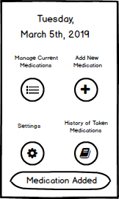
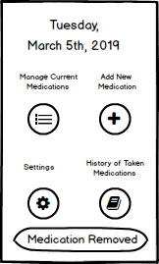
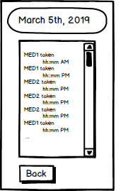
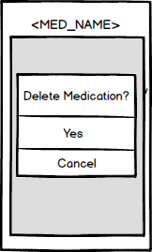
Prototype 2
Feedback given to the users for different actions completed
Updated Medication History Viewer
Confirmation popup for deleting a medication

Slide 13
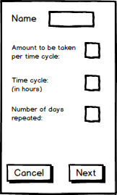
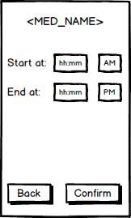
Prototype 2 User Testing
Adding a New Medication: One of the issues of this prototype was splitting up the interface for adding a new medication. The user is meant to set up the medication interval on the first screen, and then set the start and end times after they click the button labeled Next. There was no indication for what was meant to happen after they clicked the button, which would lead to them feeling stuck.

Slide 14
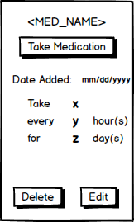
Prototype 2 User Testing
Editing an Existing Medication: Similarly to Prototype 1, users had issues clicking on fields before finding the Edit button, meaning this issue was not addressed properly after the first iteration.

Slide 15
Prototype 2 User Testing
Deleting a Medication: After clicking the button to delete the current medication, one of the users stated that the confirmation popup was confusing because the label Delete Medication appeared as if it were a selectable option when it wasn’t.

Slide 16
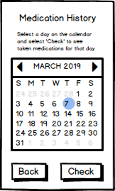
Prototype 2 User Testing
Viewing Medication History: During the task of checking previously taken medications, it was pointed out that the user should have some way of knowing what the current date is from the interface and not have to rely on checking the date from the system.

Slide 17
Prototype 3
After finishing user testing for prototype 2, these changes were made for the third iteration:
The add new medication interface has all of the necessary elements grouped together instead of two different screens.
The current medication interface displays the delete and edit buttons towards the top, instead of towards the bottom.
The prompt to confirm deleting a medication labeled “Delete Medication” looks more like a label instead of a menu option.
The medication history interface now displays what the current date it.

Slide 18
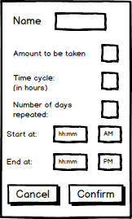
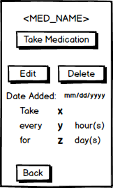
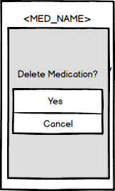
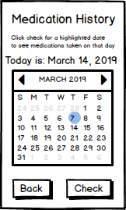
Prototype 3
Adding a new medication
Current medication information
Updated deletion confirmation
Updated medication history page

Slide 19
Questions?

